Slide 1
Engineering Chemistry
Unit V
Spectroscopic Techniques
Topic: UV-Visible Spectra and Terms
Department of Applied Science
Pune Institute of Computer Technology, Pune

Slide 2
UV-Vis Spectra
UV-Visible spectrophotometer on analysis of an analyte solution gives data in the form of UV-Vis Spectra or UV-Vis spectral data that can be converted in the spectra.
Here the absorption of UV-Visible light leads to excitation of electrons from bonding molecular orbital to antibonding molecular orbital.
This absorption depends on structure of analyte.

Slide 3
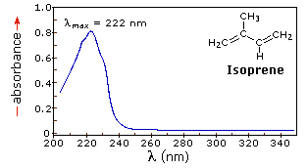
UV-Vis Spectra
The UV-Vis spectra for isoprene is as follows
Source: https://www2.chemistry.msu.edu/faculty/reusch/VirtTxtJml/Spectrpy/UV-Vis/spectrum.htm

Slide 4
UV-Vis Spectra
The UV-Vis spectra is a graph of Absorbance or % Transmittance on Y axis and Wavelength on X axis.
It gives information about:
λ_{max} = It is the wavelength at which maximum absorbance is observed. It is a characteristic property of an analyte and depends on structure of that analyte.

Slide 5
Terms in UV-Visible Spectroscopy
Chromophore: A covalently bonded group of atoms responsible for absorption of UV-Visible light, leading to electronic transition is called as chromophore e.g. C=C, C=O, C=N, benzene, butadiene etc.
Auxochrome: A saturated group of atoms that does not absorb UV-Visible light, but when attached to chromophore shift the absorption wavelength towards longer or shorter wavelength region e.g. –OH, -OCH₃, -NH₂

Slide 6
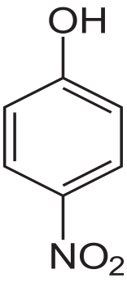

Terms in UV-Visible Spectroscopy
Bathochromic Shift (Red Shift): Shift in the λ_{max} towards longer wavelength is called as bathochromic shift, as the wavelength shift towards red region of UV-Visible light it is called as red shift
Alkaline medium
λmax =255 nm
λmax =265 nm

Slide 7
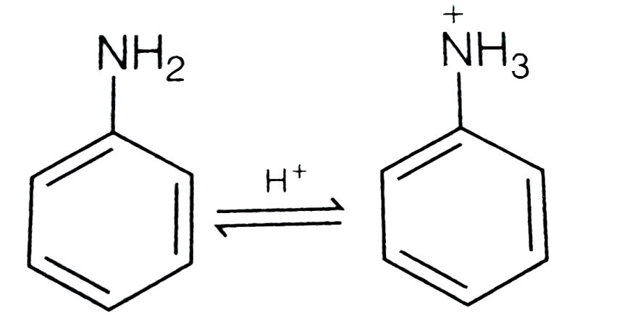
Terms in UV-Visible Spectroscopy
Hypsochromic Shift (Blue Shift): Shift in the λ_{max} towards shorter wavelength is called as hypsochromic shift, as the wavelength shift towards blue region of UV-Visible light it is called as blue shift.
λmax = 285 nm λmax = 265 nm

Slide 8
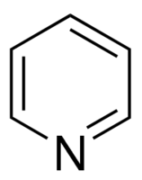
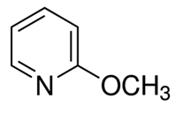
Terms in UV-Visible Spectroscopy
Hyperchromic effect: Increase in the absorption intensity i.e. ε (molar extinction coefficient) is called as hyperchromic shift. The hyperchromic shift may be due to solvent effect or auxochrome
ε = 2759 ε = 3560

Slide 9
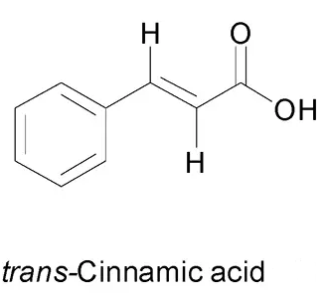
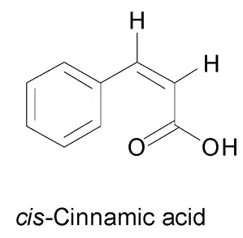
Terms in UV-Visible Spectroscopy
Hypochromic effect: Decrease in the absorption intensity i.e. ε (molar extinction coefficient) is called as hypochromic shift. The hypochromic shift may be due to solvent effect or auxochrome
ε = 15900 ε = 10700

Slide 10
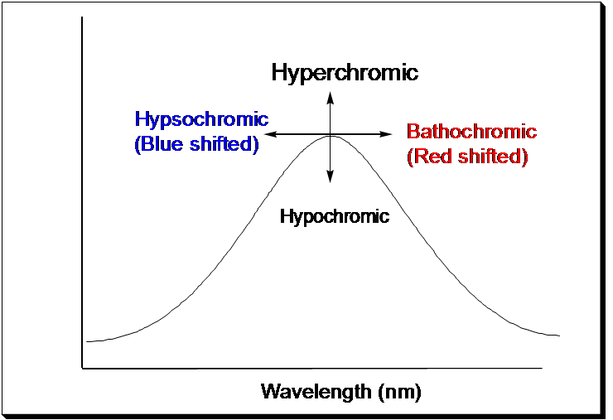
Terms in UV-Visible Spectroscopy
Source of image: http://cleanenergywiki.org/index.php?title=File:Bathochromic.png

Slide 11
Assignment
Define and give examples of Chromophore, Auxochrome, Bathochromic shift, hypsochromic shift, hyperchromic and hypochromic effect.
Explain theory of electronic transition with the help of Energy diagram.

